Slide 1

TRADE MART E-COMMERCE PLATFORM
Prashant Kumar Tripathi
23SCSE1570044
Akhilesh Chaudhary
23SCSE1570026
Section 1
Department: B Tech (CSE)
Full stack development
Dev Tomar
23SCSE1570016
Rajesh Yadav
23SCSE1570014

Slide 2
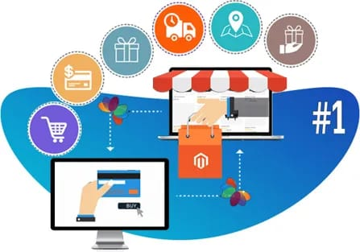
INTRODUCTION
E-commerce, short for electronic commerce, refers to the buying and selling of goods and services over the internet. It encompasses a wide range of activities, from online retail to online auctions and digital marketplaces.

Slide 3

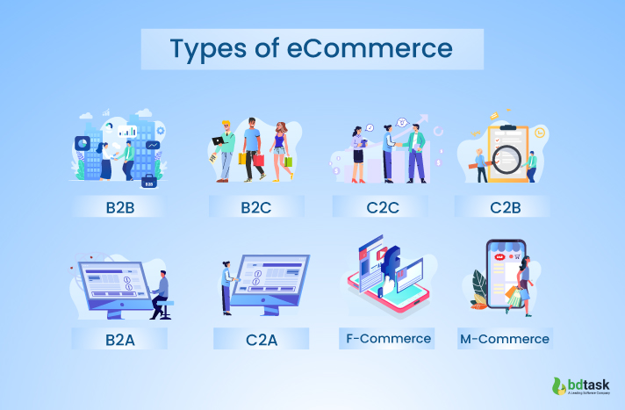
Importance of E-commerce
E-commerce platforms have become an integral part of the modern business landscape, offering numerous benefits for both businesses and consumers. Here are some key reason why e-commerce platforms are so important.
Expanded Market reach, Increased Sales and Revenue, Improved customer Experience.
Convenience, variety, Price comparison, Time Saving, etc..
Types of E-commerce
Business-to-Consumer (B2C): Businesses selling directly to consumers (e.g., Amazon, Flipkart).
Business-to-Business (B2B): Businesses selling to other businesses (e.g., Alibaba, Grainger).
Consumer-to-Consumer (C2C): Individuals selling to other individuals (e.g., eBay, Etsy).
Consumer-to-Business (C2B): Individuals selling services or products to businesses (e.g., freelance platforms, content marketplaces).

Slide 4
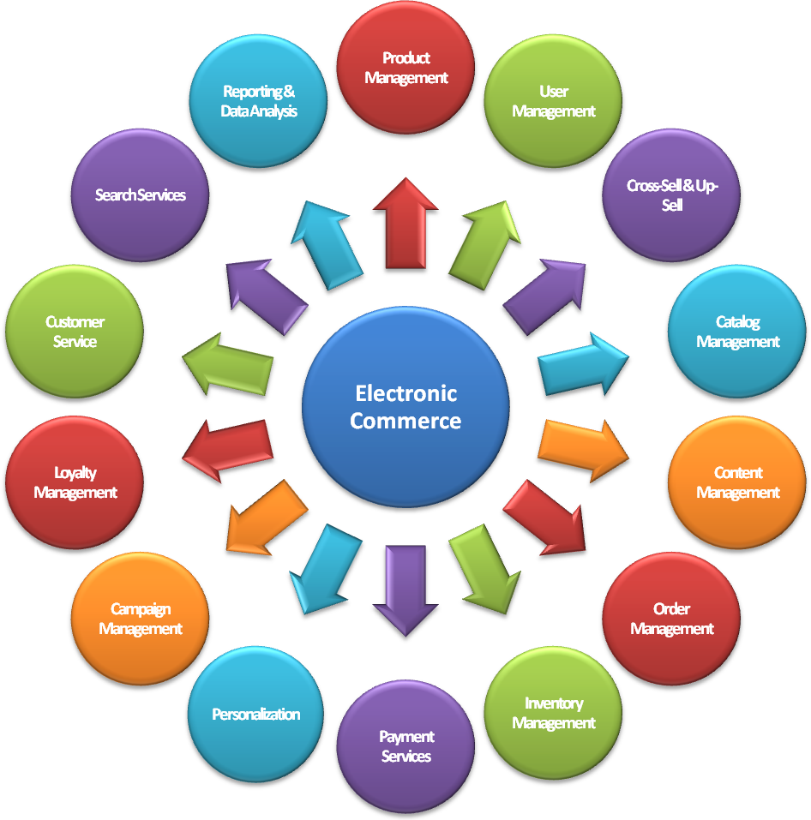
Key components of E-commerce

Slide 5
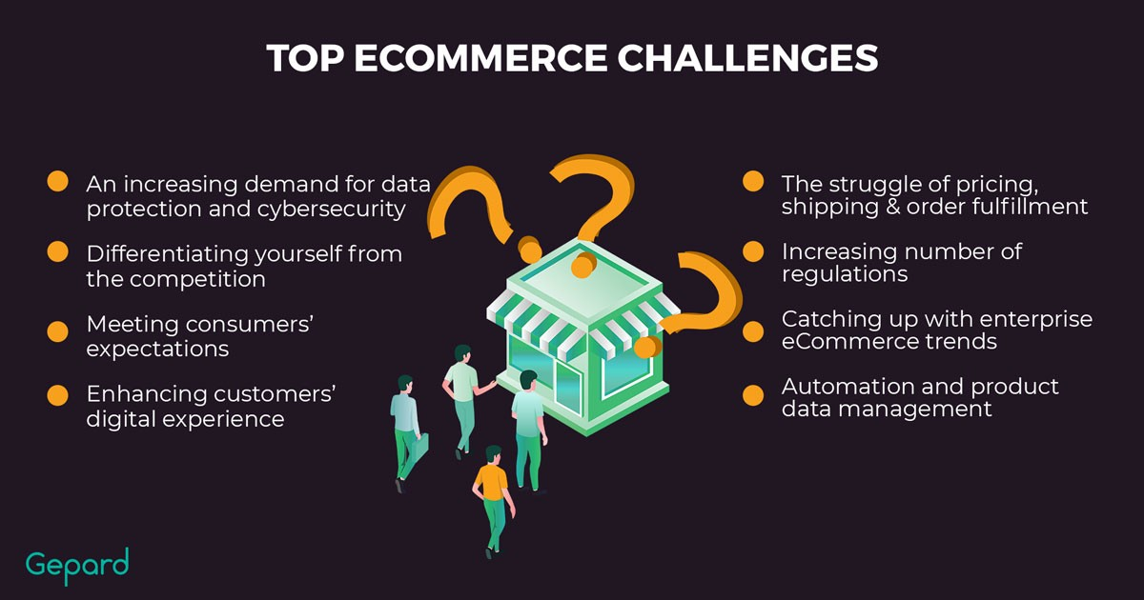
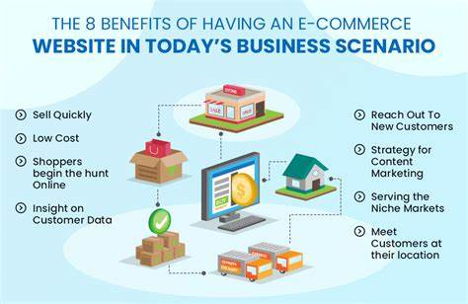
Benefits
Global Reach: Selling products to customers worldwide.
24/7 Accessibility: Customers can shop anytime, anywhere.
Lower Costs: Reduced overhead expenses compared to traditional brick-and-mortar stores.
Data-Driven Insights: Analyzing customer behavior and preferences to improve business decisions.
Convenience: Customers can shop from the comfort of their homes.
Competition: Intense competition from other online retailers.
Security Concerns: Protecting customer data and preventing fraud.
Return Policies: Handling returns and refunds efficiently.
Challenges

Slide 6

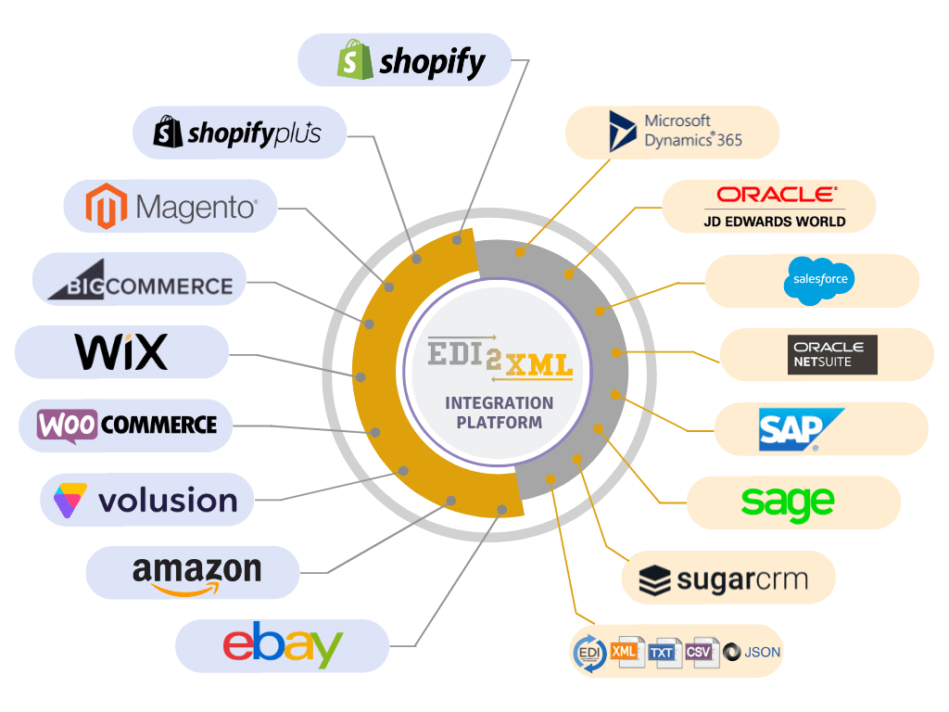
Technology uses
Web Development Technologies
Programming Languages: For forentend and backend development we are going to use java language.
Database: MySQL for storing product data, customer information and
orders .
Frameworks: React, Angular, Vue.js, and Django are popular frameworks that streamline development and provide reusable components.
Content Management Systems (CMS): Platforms like WordPress, Magento, and Shopify offer pre-built templates and features for managing content and products.
Payment Gateways :
PayPal, Stripe, Phonepay , google pay and Braintree are commonly used for processing online payments. Which provide us secure transactions.
Analytics tools , SEO (Search engine Optimization) etc.
NEW:
AI: Personalized Recommendation: By using AI algorithm to provide personalized product recommendation based on their browsing history, customer preference and purchase behavior.
Chatbots.

Slide 7

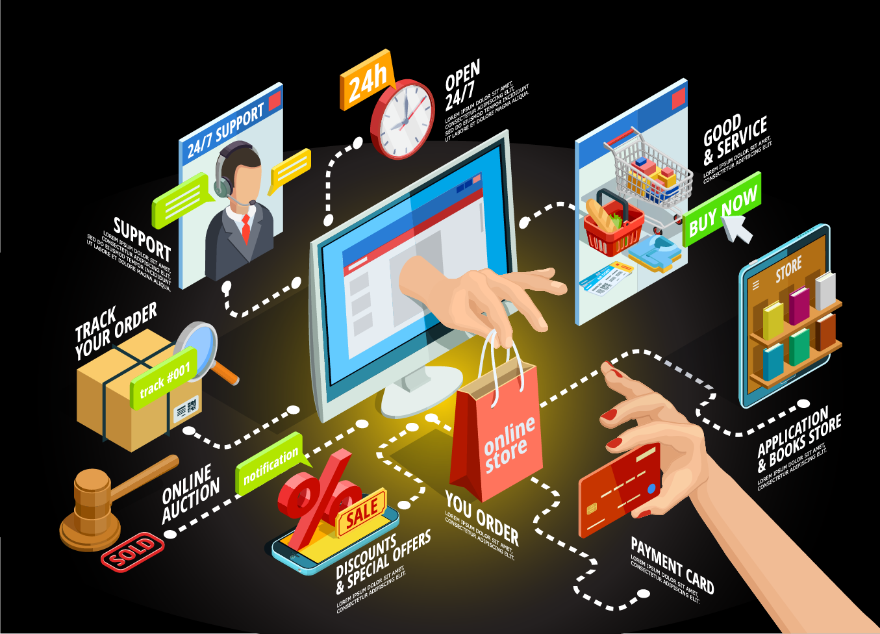
Conclusion
The conclusion of an e-commerce platform Java project highlights the successful development and implementation of a functional online marketplace. The platform allows users to browse products, manage carts, and make secure transactions, while administrators can manage inventory, orders, and customer data. The project demonstrates the application of core Java concepts such as object-oriented programming, database integration, and web technologies like servlets and JSP. Overall, it showcases the ability to create scalable, secure, and user-friendly e-commerce solutions that meet modern business needs

Slide 8
THANK YOU

